Slide 1
Cutting the space shuttle budget: an end to an era
Chelsea Pence

Slide 2
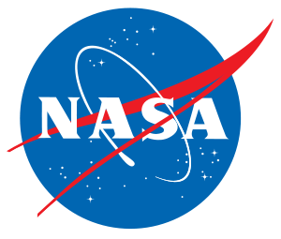
National Aeronautics Space Administration (formerly NACA)
Was founded July 29, 1958
Attempt at rivaling the Soviet space program
Space Shuttle Program

Slide 3
Budget Cuts
$241 million in 2011.
Cuts the budget in about 1.3%
$18.72 billion down to $18.48 billion.
That doesn’t seem like much…

Slide 4
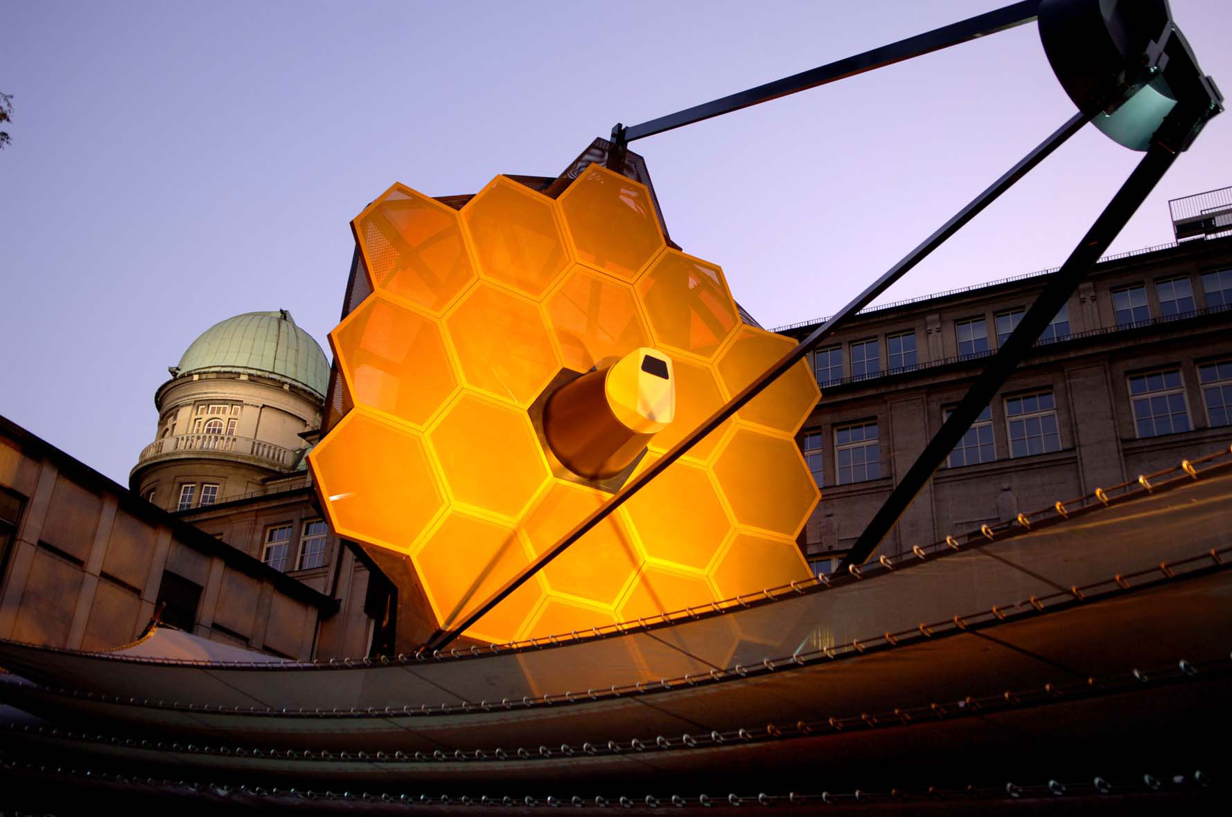
What is still available at NASA?
$3.8 billion for exploration programs
$1.2 billion for building a multipurpose crew vehicle
$1.8 billion for a heavy- rocket
The James Webb Space Telescope
Notes:
“The ramifications of the continued cuts to NASA and similar science-driven programs cannot be quantified, but would surely manifest themselves in various negative ways in the future” –Jacob Lubman

Slide 5
"The leaked internal E-mail fails to provide the contextual framework for my remarks, and my support for the administration's policies. Administration policy is to retire the space shuttle in 2010 and purchase crew transport from Russia until Ares and Orion are available. “
—Michael D. Griffin
September 7, 2008

Slide 6
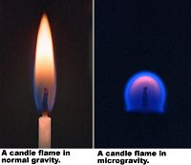
Why we should explore space….
The Earth is finite
Knowledge is the core to being a human
Although we are capable of creating vacuum chambers, we cannot mimic space entirely.
Notes:
Flames are a good example. On Earth, flames have a teardrop shape caused by hot air rising in a gravitational field. On board a spaceship, however, flames break apart into little balls that move around like UFOs. They burn using almost no fuel--something researchers would like to replicate in gas-saving auto engines. One of the experiments on STS-107, called SOFBALL-2, will ignite some flame balls and measure their properties. Scientists hope to learn how they burn and what keeps them lit.

Slide 7
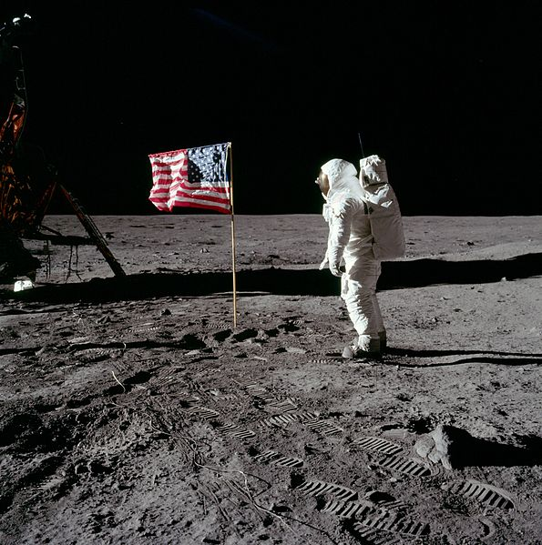
Accomplishments of the Space Shuttle Program
Spacelab missions
Mir and International Space Station
Hubble Space Telescope
Manned experiments in low Earth orbit

Slide 8
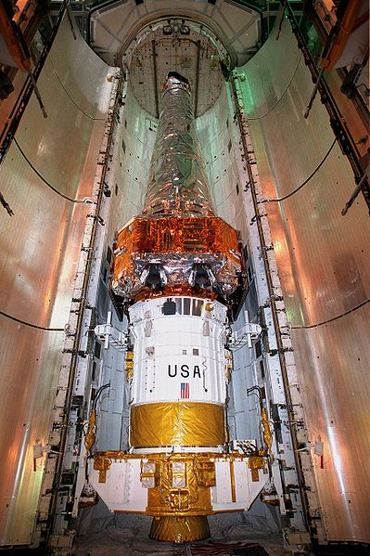
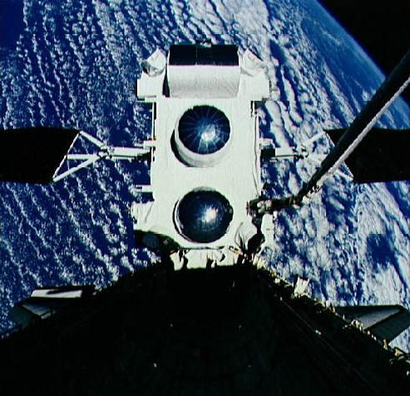
Major Scientific Discoveries
NASA’s Great Observatories
Hubble Space Telescope
Compton Gamma Ray Observatory
Chandra X-ray Observatory
Spitzer Space Telescope

Slide 9
Shuttle accidents
Challenger
Columbia
Notes:
000000http://www.nasa.gov/centers/johnson/pdf/584718main_Wings-ch2a-pgs11-31.pdf
The main cause of the explosion was the failure of the aft joint seal in the right SRB due to the cold weather. A combustion gas leak through the right Solid Rocket Motor aft field joint initiated at or shortly after ignition eventually weakened and/or penetrated the External Tank initiating vehicle structural break-up and loss of the Space Shuttle Challenger during STS Mission 51-L.
The loss of Columbia was a result of damage sustained during launch when a piece of foam insulation the size of a small briefcase broke off from the Space Shuttle external tank(the 'ET' main propellant tank) under the aerodynamic forces of launch. The debris struck the leading edge of the left wing, damaging the Shuttle's thermal protection system (TPS), which shields it from the intense heat generated from atmospheric friction during re-entry. WhileColumbia was still in orbit, some engineers suspected damage, but NASAmanagers limited the investigation, on the grounds that little could be done even if problems were found.

Slide 10
Hubble
13.7 billion years old
Nearly all galaxies may harbor supermassive black holes
How planets form Extrasolar Organic matter
Dark Energy
Plutonian moons
Notes:
http://www.nasa.gov/mission_pages/hubble/main/index.html

Slide 11
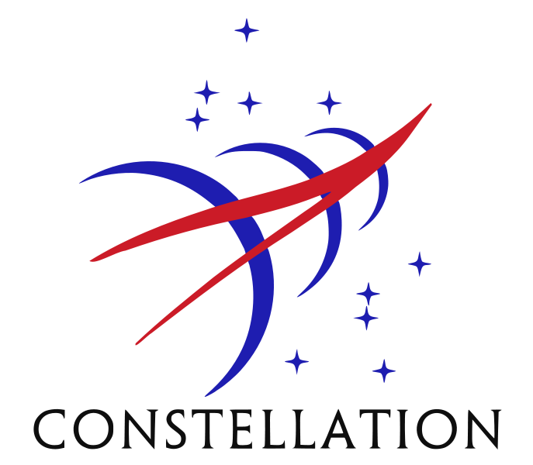
The Constellations Program
Consists of Ares, Orion, and Altair space vehicles.
Incorporates new engineering technology and new innovative space suit technology.

Slide 12
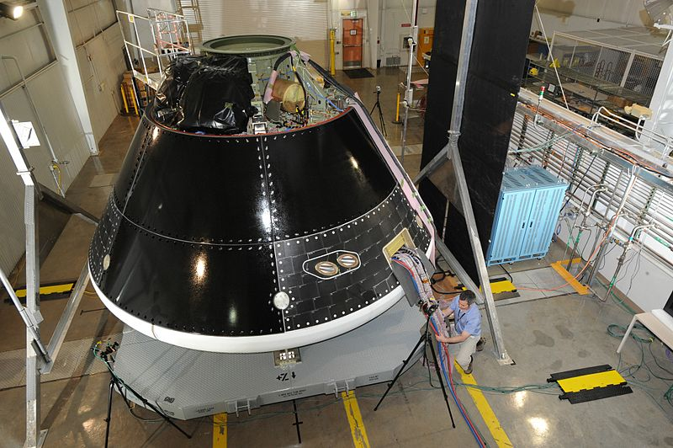
Orion
Multi-purpose crew vehicle
“Provides our nation with an affordable solution for multiple mission capability by continuing the NASA-industry team’s technology innovations and spacecraft”
Leading Edge Design and Engineering
Notes:
http://www.nasa.gov/exploration/systems/mpcv/index.html

Slide 13
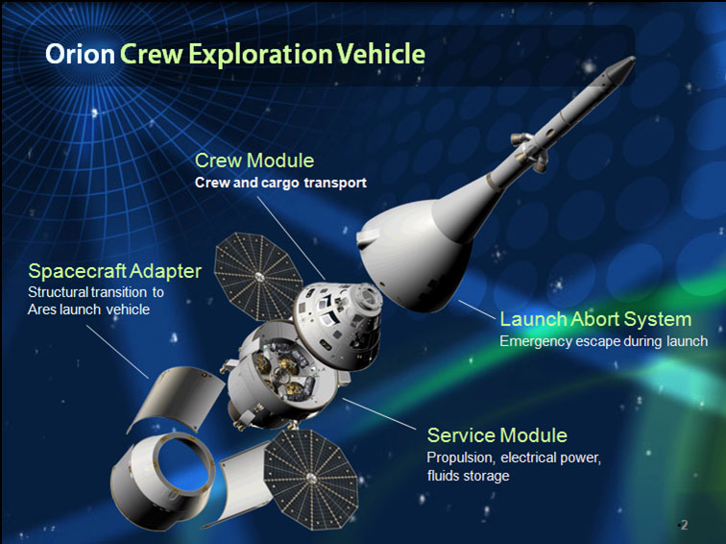

Slide 14
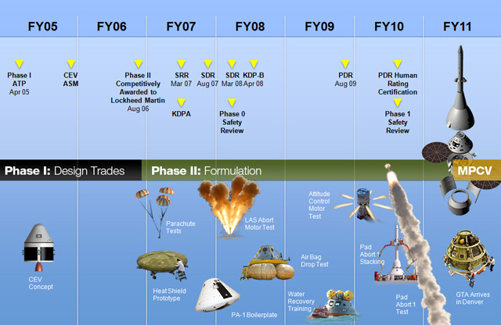

Slide 15
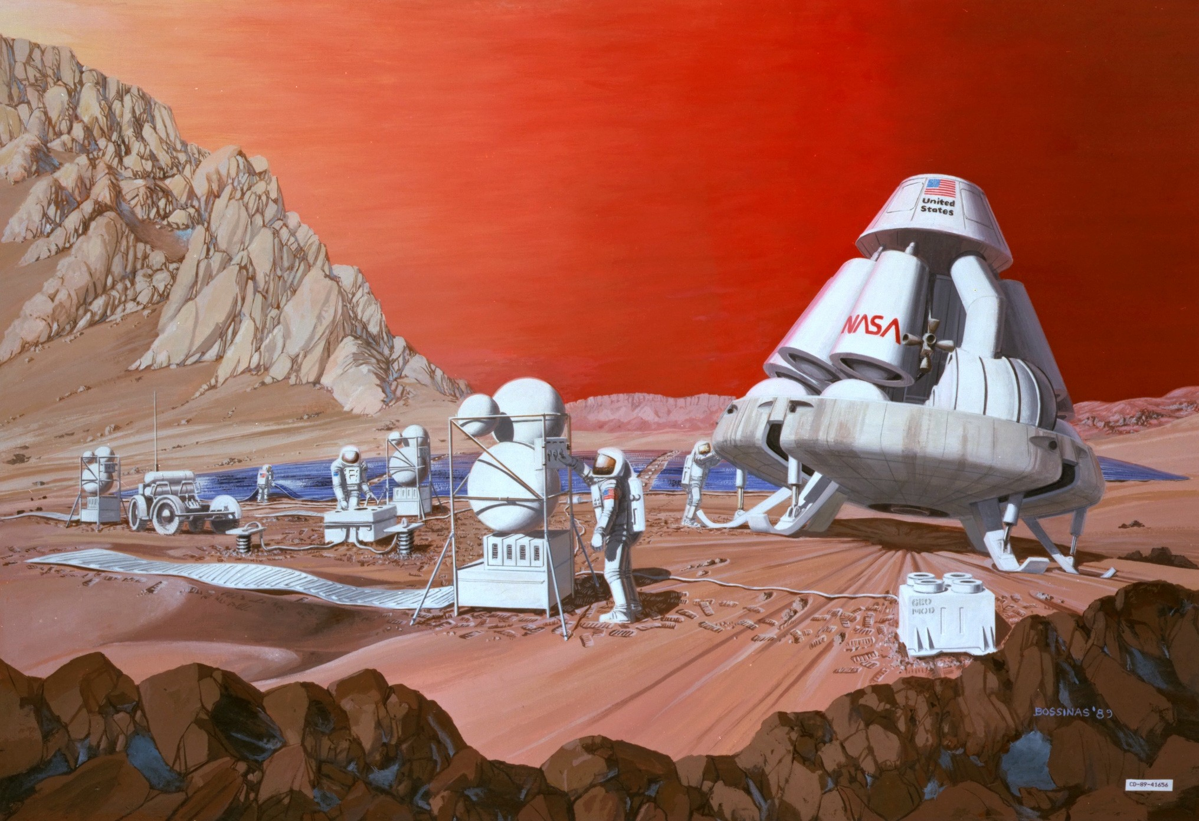

Slide 16
Alternate Funding
Commercial Crew Development
$50 million to private sectors from NASA
Boeing $1.8M
UNA $6.7M
Blue origin $3.7M
Paragon Space $1.4M
Sierra Nevada $20M

Slide 17
http://www.youtube.com/watch?v=RQhNZENMG1o
Neil deGrasse Tyson:

Slide 18
Resources
Brusso, C.. (2011, October). FIRST CONTACT: SCIENTIFIC BREAKTHROUGHS IN THE HUNT FOR LIFE BEYOND EARTH Ad Astra, 23(3), 49. Retrieved October 17, 2011, from Research Library. (Document ID: 2429453371).
Curtin, N. P., & United States. (1992). NASA Budget: Potential shortfalls in funding NASA’s 5- year plan: statement of Neal P. Curtin, Director of Planning and Reporting, National Security and International Affairs Division, before the Subcommittee on Science, Technology, and Space, Committee on Commerce, Science, and Transportation, United States Senate. Washington, D.C.: U.S. General Accounting Office.
Wilson, J. (2011, September 15). What’s next for NASA? Retrieved from http://www.nasa.gov/about/whats_next.html
Bearden, D. (2008, June 3). Perspectives on NASA mission cost and schedule performance trends. Retrieved from http://ses.gsfc.nasa.gov/ses_data_2008/080603_Bearden.ppt
Lubman, J., (2011, July 19). Cuts in NASA funding a step in the wrong direction for US. The Daily Atheneaum. Retrieved from http://www.thedaonline.com/opinion/cuts-in-nasa-funding-a-step-in-the-wrong-direction-for-us-1.2530184#.Tpz3O96ImU9.
Anonymous., (2008, August) The history of astronomy. Oracle Education. Retrieved from http://library.thinkquest.org/29033/history/history.htm
Landis, R., Korsmeyer, D., Abell, P., & Adamo, D. (2008). A piloted Orion flight to a near-earth object: a feasibility study. Retrieved from http://ti.arc.nasa.gov/m/project/neo/pdf/NEO_feasibility.pdf
Netting, Ruth. "Science that can't be done on Earth." Nasa.gov. NASA, April 6, 2011. Web. 21 Nov 2011. <http://science.nasa.gov/science-news/science-at-nasa/2003/16jan_sts107/>.

